Slide 1
Information Systems
Surendra K.C.

Slide 2
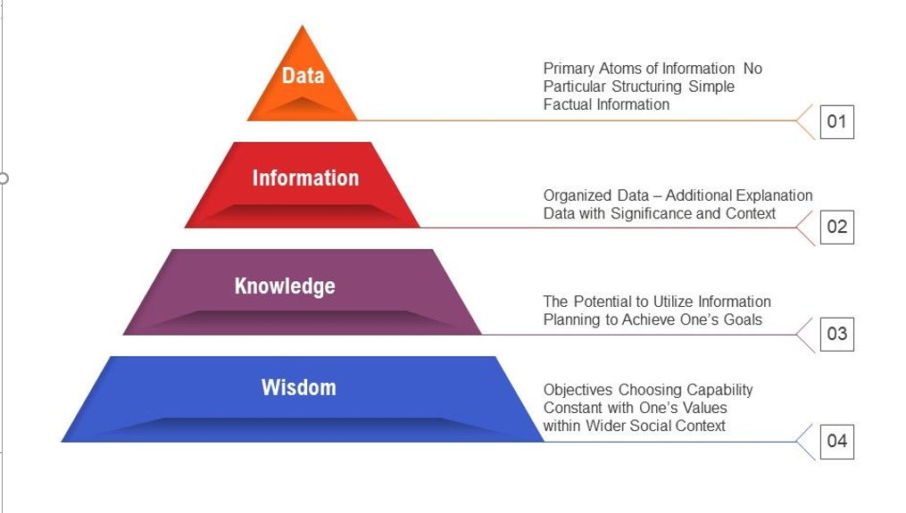

Slide 3
Data vs Information vs Knowledge vs Wisdom
Data are raw facts or figures that are devoid of any context or meaning. Examples include numbers, text, images, or symbols. Data alone lack significance until they are processed and organized into a meaningful structure.
Information is the result of processing, organizing, and interpreting data to make it meaningful and useful. It provides context, relevance, and purpose to data.
Knowledge is a higher-level abstraction that goes beyond mere information. It involves understanding and insights derived from information, experience, and expertise.
Knowledge enables individuals or organizations to make informed decisions, solve problems, and create new ideas. Unlike information, knowledge is subjective and context-dependent.
It encompasses concepts, beliefs, judgments, and experiences. For example, understanding the trends revealed by sales data and using that insight to formulate a marketing strategy represents the application of knowledge.
In information systems, the goal is to transform data into actionable knowledge that can support decision-making and problem-solving processes.
Wisdom involves the application of knowledge, experience, and understanding to navigate complex situations, make sound judgments, and achieve meaningful outcomes. It goes beyond mere accumulation of facts to incorporate deeper insights and understanding.
Wisdom involves intuition, emotional intelligence, and the ability to understand and manage one's emotions and those of others. It enables individuals to navigate uncertainties, complexities, and conflicts with grace and resilience
Wisdom incorporates elements such as intuition, empathy, ethics, and a broader perspective on life and human nature.

Slide 4
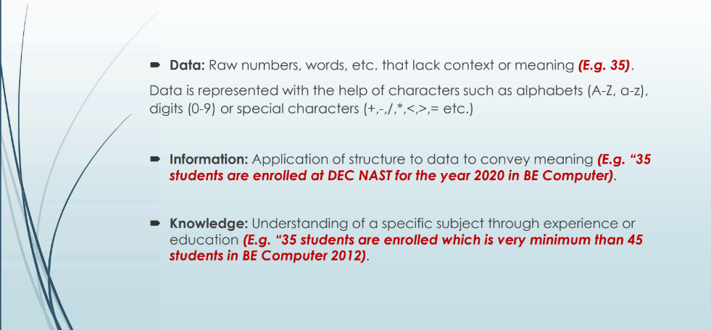

Slide 5
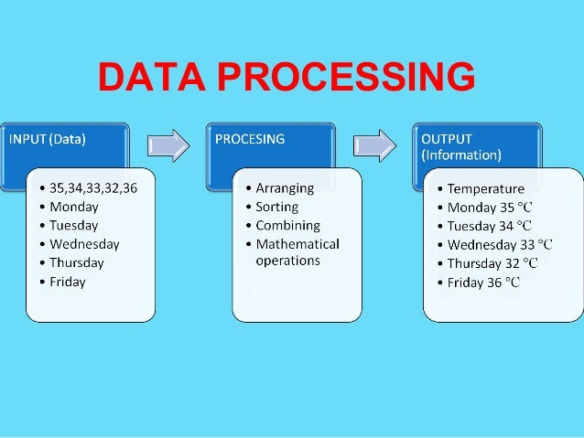

Slide 6
Information Systems
An information system is a combination of hardware, software, data, procedures, and people that work together to collect, process, store, and disseminate information for decision-making and problem-solving within an organization or across multiple organizations.
IT refers to the hardware, software, networks, and infrastructure used to manage, process, store, and transmit data and information.
It encompasses a wide range of technologies and tools that enable the collection, processing, storage, retrieval, and dissemination of information. Examples of IT components include computers, servers, networking equipment, databases, software applications, and telecommunications systems.
Information systems are broader than IT and encompass the entire framework of people, processes, data, and technology used to support organizational goals and objectives. An information system includes not only the hardware and software components but also the procedures, policies, and people involved in collecting, processing, storing, and disseminating information.

Slide 7
Components of Information Systems
Hardware
Physical devices used to collect, process, store, and transmit data. This includes computers, servers, storage devices, networking equipment, and peripheral devices such as printers and scanners.
Software
Programs and applications that enable users to interact with the hardware and perform specific tasks. This includes operating systems, database management systems, enterprise applications (e.g., ERP, CRM), productivity software, and custom-developed software.
Data
Raw facts, figures, and other details that are collected, processed, and stored by the information system. Data can be structured (e.g., databases, spreadsheets) or unstructured (e.g., documents, multimedia files) and may come from various sources both internal and external to the organization
Network
Communication pathways that enable the transfer of data between different components of the information system and with external entities. This includes local area networks (LANs), wide area networks (WANs), intranets, extranets, and the internet

Slide 8
Components of Information Systems
Procedure
Standardized processes, protocols, and guidelines that govern how data is collected, processed, stored, and managed within the information system. This includes data entry procedures, security protocols, backup and recovery processes, and data governance policies.
People
Users who interact with the system to input, access, and analyze information, as well as IT professionals who design, develop, implement, and maintain the system. This includes stakeholders from various departments such as management, marketing, finance, operations, and IT who rely on the information system to support their daily activities and decision-making processes.
Feedback
Systems and processes for gathering feedback from users and stakeholders to evaluate the performance, usability, and effectiveness of the information system. This includes user surveys, performance metrics, usability testing, and other feedback channels used to identify areas for improvement.

Slide 9
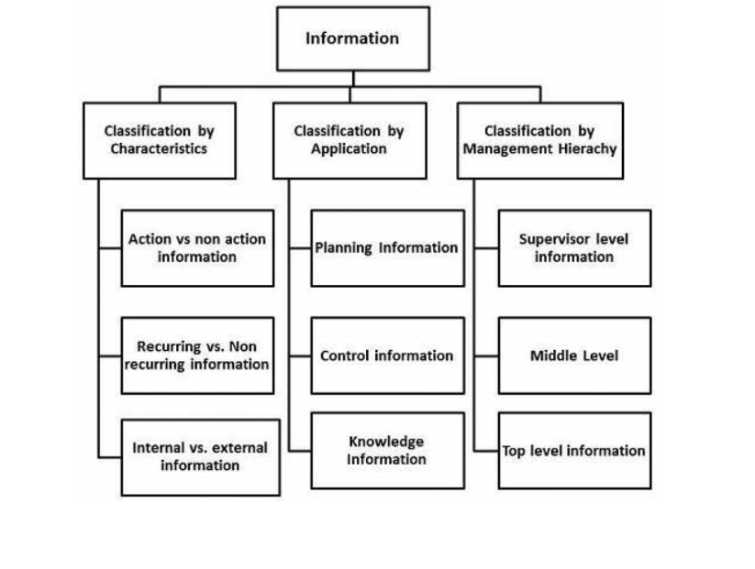
Classification of Information

Slide 10
Action vs non-action information
Action Information:
Definition: Action information is information that prompts or requires a decision or action to be taken by an individual or organization.
Characteristics: Action information is typically timely, relevant, and specific to a particular decision or problem. It provides insights or recommendations that directly influence decisions or trigger actions.
Example: A sales report indicating a decline in sales for a particular product line may prompt a manager to take action, such as adjusting marketing strategies, revising pricing, or reallocating resources to address the issue.
Non-action Information:
Definition: Non-action information is information that does not immediately require a decision or action to be taken. It may be informative or interesting but does not directly impact decision-making processes.
Characteristics: Non-action information may include general background information, historical data, or contextual details that provide a broader understanding of a situation but do not necessarily drive specific actions.
Example: A market research report providing demographic trends and consumer preferences in a particular region may be valuable for long-term strategic planning but may not necessitate immediate action.

Slide 11
Recurring vs non-recurring information
Recurring Information:
Definition: Recurring information refers to data, reports, or updates that occur regularly or at predefined intervals within a specific timeframe.
Characteristics: Recurring information follows a predictable schedule and is generated or updated periodically. It may include daily, weekly, monthly, quarterly, or annual reports, updates, or data feeds.
Example: Daily sales reports, weekly production summaries, monthly financial statements, quarterly performance reviews, and annual budget forecasts are examples of recurring information.
Non-Recurring Information:
Definition: Non-recurring information is data, reports, or updates that do not follow a regular or predictable schedule and occur infrequently or on an ad-hoc basis.
Characteristics: Non-recurring information is often generated in response to specific events, situations, or requests that do not occur regularly. It may include one-time analyses, special reports, ad-hoc queries, or unique data sets.
Example: A market research study commissioned for a specific project, a feasibility analysis for a new product launch, an investigation report following a security breach, and a customer satisfaction survey conducted sporadically are examples of non-recurring information.

Slide 12
Internal vs external information
Internal Information:
Definition: Internal information originates from within the organization itself. It includes data generated by the organization's own operations, processes, and systems, as well as insights derived from internal analysis and reporting.
Characteristics: Internal information is specific to the organization and its activities. It may include data related to sales, production, finance, human resources, inventory, customer relationships, and other internal functions.
Examples: Sales data from internal transactions, employee performance records, production schedules, financial statements, internal memos and reports, and meeting minutes.
External Information:
Definition: External information comes from sources outside the organization. It includes data, insights, and intelligence obtained from external sources such as customers, competitors, suppliers, industry analysts, government agencies, and market research firms.
Characteristics: External information provides context and insights into factors outside the organization's control that may impact its operations and performance. It may include market trends, competitor analysis, regulatory changes, economic indicators, consumer preferences, and industry benchmarks.
Examples: Market research reports, industry publications, competitor product reviews, customer feedback, economic forecasts, regulatory updates, and news articles.

Slide 13
Planning Information
"Planning information" refers to data, insights, and analyses used in the process of strategic planning within an organization. This type of information is crucial for setting goals, defining strategies, allocating resources, and making decisions to achieve long-term objectives.
Characteristics:
Long-term Focus: Planning information typically focuses on long-term goals and objectives rather than short-term operational concerns. It helps organizations set direction and establish priorities for future activities.
Strategic Perspective: Planning information provides a strategic perspective on the organization's environment, competitors, market trends, opportunities, and threats. It helps identify strategic opportunities and challenges that may impact the organization's success.
Data-driven: Planning information is based on data, research, analysis, and forecasts rather than intuition or guesswork. It involves gathering and analyzing relevant data to support informed decision-making and strategic planning processes.
Holistic: Planning information considers various aspects of the organization, including financial, operational, market, technological, and human resources. It integrates data from different sources and disciplines to provide a comprehensive view of the organization's current state and future prospects.

Slide 14
Planning information
Examples:
Market Research Reports: Reports and analyses on market trends, customer preferences, demographics, competitors, and industry dynamics provide valuable insights for strategic planning.
SWOT Analysis: A SWOT (Strengths, Weaknesses, Opportunities, Threats) analysis identifies internal strengths and weaknesses and external opportunities and threats, helping organizations formulate strategies to leverage strengths and opportunities while mitigating weaknesses and threats.
Financial Forecasts: Financial projections, budget forecasts, and financial modeling help organizations anticipate future revenue, expenses, cash flow, and profitability, guiding resource allocation and investment decisions.
Strategic Plans: Formal strategic plans outline the organization's mission, vision, goals, objectives, and strategies for achieving them. They provide a roadmap for future actions and initiatives.
Scenario Planning: Scenario planning involves creating alternative future scenarios based on different assumptions and factors to anticipate and prepare for various possible outcomes and risks.
Benchmarking Data: Comparative data on key performance indicators (KPIs), industry benchmarks, and best practices help organizations assess their performance relative to peers and identify areas for improvement.

Slide 15
Strategic Planning:
Purpose: Strategic planning focuses on defining the organization's long-term goals, objectives, and strategies to achieve its vision and mission. It involves assessing the organization's external environment, identifying opportunities and threats, and determining the direction the organization should take.
Scope: Strategic planning addresses high-level issues such as market positioning, competitive advantage, growth opportunities, and overall organizational development.
Timeframe: Strategic planning typically covers a long time horizon, often ranging from three to ten years or more.
Key Outputs: The key outputs of strategic planning include a mission statement, vision statement, long-term goals and objectives, strategic initiatives, and a strategic plan document.
Example: Developing a five-year strategic plan outlining the organization's growth targets, market expansion strategies, and investment priorities.
Tactical Planning:
Purpose: Tactical planning translates the broad objectives and strategies defined in the strategic plan into specific action plans and initiatives to be implemented in the short to medium term. It focuses on allocating resources, setting priorities, and coordinating activities to achieve strategic goals.
Scope: Tactical planning addresses operational issues such as resource allocation, project planning, budgeting, and performance targets within specific functional areas or departments.
Timeframe: Tactical planning typically covers a shorter time horizon compared to strategic planning, usually one to three years.
Key Outputs: The key outputs of tactical planning include annual operating plans, departmental budgets, project schedules, and performance targets.
Example: Developing an annual marketing plan outlining specific campaigns, advertising strategies, promotional activities, and budget allocations to support the organization's strategic marketing objectives.
Operational Planning:
Purpose: Operational planning focuses on day-to-day activities and processes necessary to execute the tactical plans and achieve operational efficiency. It involves setting short-term objectives, assigning tasks, and coordinating activities to ensure the smooth functioning of the organization.
Scope: Operational planning addresses routine tasks, processes, and procedures within specific operational areas such as production, sales, inventory management, and customer service.
Timeframe: Operational planning typically covers a very short time horizon, often weeks or months.
Key Outputs: The key outputs of operational planning include work schedules, production plans, inventory management plans, staffing plans, and daily or weekly activity plans.
Example: Developing a weekly production schedule outlining the specific tasks, timelines, and resource requirements for each production line to meet customer demand and quality standards.

Slide 16
Control Information
"Control information" can refer to various types of data, reports, or mechanisms used within an organization to monitor, regulate, and manage operations, processes, and resources. It plays a crucial role in ensuring that activities are carried out effectively, efficiently, and in accordance with established standards and objective
Financial Control Information:
Financial control information includes budget reports, financial statements, cost analyses, and expenditure tracking data used to monitor and manage financial resources within an organization. It helps ensure that spending aligns with budgets, financial goals, and regulatory requirements.
Operational Control Information:
Operational control information consists of reports, metrics, and performance indicators that track the efficiency, productivity, and quality of operational processes. It helps identify areas for improvement, streamline workflows, and optimize resource utilization.
Quality Control Information:
Quality control information includes data on product quality, defect rates, customer complaints, and quality assurance measures used to monitor and maintain product and service quality. It ensures that products and services meet or exceed customer expectations and regulatory standards.
Compliance Control Information:
Compliance control information encompasses policies, regulations, audit findings, and compliance reports used to ensure that organizational activities adhere to legal and regulatory requirements. It helps mitigate risks, prevent violations, and maintain organizational integrity.

Slide 17
Control Information
Risk Control Information:
Risk control information includes risk assessments, risk registers, risk mitigation plans, and incident reports used to identify, assess, and mitigate risks within an organization. It helps safeguard against potential threats to operations, assets, and reputation.
Security Control Information:
Security control information comprises security policies, access logs, intrusion detection reports, and vulnerability assessments used to protect organizational assets, data, and systems from unauthorized access, breaches, and cyber threats.
Project Control Information:
Project control information includes project plans, progress reports, milestone tracking data, and issue logs used to monitor and manage project activities, schedules, and budgets. It ensures that projects are delivered on time, within budget, and according to specifications.
Change Control Information:
Change control information consists of change requests, change logs, change impact assessments, and change management reports used to manage changes to processes, systems, and organizational structures. It helps minimize disruptions and ensure that changes are implemented smoothly and effectively.

Slide 18
Knowledge Information
"Knowledge information" typically refers to data, insights, or content that contribute to the creation, accumulation, or dissemination of knowledge within an organization or society. In the context of information systems and knowledge management, knowledge information plays a crucial role in facilitating learning, problem-solving, innovation, and decision-making processes. Here are some key aspects of knowledge information:
Explicit Knowledge:
Explicit knowledge is formalized and codified information that can be easily articulated, documented, and shared. It includes facts, theories, concepts, procedures, and other structured forms of knowledge that are readily accessible.
Example: Manuals, textbooks, databases, reports, and documented best practices are examples of explicit knowledge.
Tacit Knowledge:
Tacit knowledge is personal, experiential, and difficult to formalize or communicate. It resides in individuals' minds and is often based on intuition, expertise, insights, and practical know-how gained through experience.
Example: Skills, expertise, intuition, insights, and personal experiences are examples of tacit knowledge.
Knowledge Management:
Knowledge management involves processes, strategies, and technologies designed to identify, capture, store, share, and leverage knowledge assets within an organization. It aims to facilitate knowledge creation, transfer, and utilization to improve organizational performance and innovation.
Example: Knowledge repositories, communities of practice, expert directories, and collaboration platforms are tools and mechanisms used in knowledge management initiatives.

Slide 19
Knowledge Information
Knowledge Sharing:
Knowledge sharing is the process of exchanging and disseminating knowledge among individuals, teams, departments, or organizations. It involves communication, collaboration, and the transfer of expertise, insights, and lessons learned.
Example: Training sessions, mentoring programs, peer-to-peer knowledge sharing, and online forums are platforms and practices used to facilitate knowledge sharing.
Decision Support:
Knowledge information supports decision-making processes by providing insights, analysis, and expertise to inform strategic, operational, and tactical decisions. Decision support systems and business intelligence tools help users access and interpret relevant knowledge information to make informed decisions.
Example: Business intelligence dashboards, data analytics reports, and expert systems provide decision-makers with actionable insights derived from knowledge information.
Innovation:
Knowledge information fuels innovation by enabling organizations to generate new ideas, solutions, and approaches to challenges. It provides the foundation for creativity, problem-solving, and continuous improvement.
Example: Research and development activities, brainstorming sessions, and cross-functional collaboration are methods used to leverage knowledge information for innovation.

Slide 20
Organizational information
Operational Information:
Operational information pertains to day-to-day activities and processes within the organization. It includes data related to sales, production, inventory, customer service, and other operational functions.
Example: Sales reports, production schedules, inventory levels, customer feedback, and employee work schedules are types of operational information.
Financial Information:
Financial information relates to the organization's financial performance, transactions, and resources. It includes data on revenues, expenses, assets, liabilities, budgets, and financial statements.
Example: Income statements, balance sheets, cash flow statements, budget reports, and financial forecasts are types of financial information.
Human Resources Information:
Human resources information pertains to personnel, staffing, and workforce management within the organization. It includes data on employees, job roles, skills, training, performance evaluations, and compensation.
Example: Employee records, job descriptions, performance evaluations, training logs, and payroll data are types of human resources information.
Customer Information:
Customer information pertains to interactions, preferences, and feedback from customers. It includes data on customer demographics, purchasing behavior, satisfaction levels, and loyalty.
Example: Customer profiles, purchase histories, feedback surveys, and customer support tickets are types of customer information.
Market Information:
Market information relates to the external market environment in which the organization operates. It includes data on industry trends, competitor activities, consumer behavior, and market demand.
Example: Market research reports, competitor analyses, industry benchmarks, and consumer surveys are types of market information.

Slide 21
Database Information
Structured Data:
Structured data is organized into tables with rows and columns, following a predefined schema. It represents factual information that can be easily categorized, queried, and analyzed.
Example: Customer information (e.g., name, address, contact details), product details (e.g., SKU, description, price), transaction records (e.g., date, time, amount), and employee data (e.g., ID, department, salary) are types of structured data.
Unstructured Data:
Unstructured data does not adhere to a predefined schema and may include text, images, audio, video, and other multimedia content. It requires specialized techniques for storage, retrieval, and analysis.
Example: Text documents, email messages, social media posts, images, videos, and audio recordings are types of unstructured data.
Metadata:
Metadata provides descriptive information about the data stored in the database, such as its structure, format, relationships, and usage. It facilitates data management, discovery, and understanding.
Example: Table names, column names, data types, primary keys, foreign keys, indexes, constraints, and data dictionary entries are types of metadata stored in databases.
Indexes:
Indexes are data structures that improve the speed of data retrieval operations by allowing quick access to specific data based on indexed columns.
Example: A database index on a customer's last name column enables faster retrieval of customer records based on their last name.
Query Results:
Query results are the output of database queries executed against the database. They represent subsets of data that meet specific criteria or conditions.
Example: The result of a SELECT query retrieving all customers who purchased a particular product in the last month is a set of query results.
Transactional Data:
Transactional data records individual transactions or events that occur within the organization. It includes details such as transaction IDs, timestamps, and transactional attributes.
Example: Sales transactions, purchase orders, invoices, payment records, and inventory updates are types of transactional data stored in databases.

Slide 22
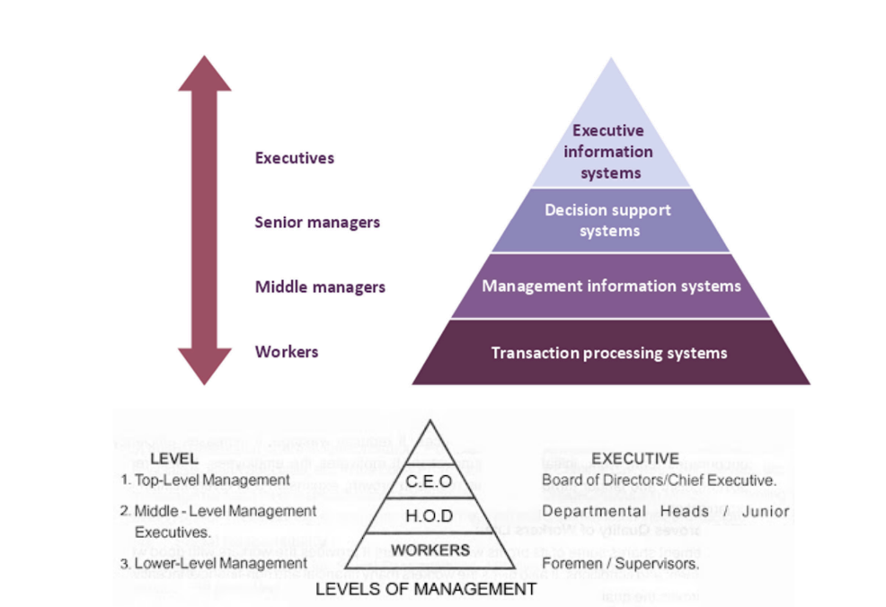

Slide 23
Top level information
Top-Level Information:
Definition: Top-level information, also known as executive information, is critical for strategic decision-making at the highest levels of the organization. It provides insights into the overall performance, direction, and long-term goals of the organization.
Characteristics:
Strategic in nature, focusing on the organization's vision, mission, and long-term objectives.
Provides an overview of the external environment, market trends, and competitive landscape.
Emphasizes high-level financial summaries, performance metrics, and key performance indicators (KPIs).
Examples:
Executive dashboards presenting summarized financial data and KPIs.
Strategic plans outlining the organization's goals, objectives, and growth strategies.
Market research reports analyzing industry trends and competitive intelligence.

Slide 24
Middle level information
Mid-Level Information:
Definition: Mid-level information, also known as managerial or tactical information, supports decision-making by middle managers responsible for implementing strategies and coordinating activities within departments or teams.
Characteristics:
More detailed than top-level information, focusing on specific projects, initiatives, or operational areas.
Helps in resource allocation, performance monitoring, and coordination of activities to achieve departmental goals.
Includes operational plans, departmental budgets, and performance reports.
Examples:
Departmental budgets detailing expenditure allocations and revenue forecasts.
Project plans outlining timelines, milestones, and resource requirements.
Performance reports tracking key metrics and progress towards departmental objectives.

Slide 25
Low level information
Low-Level Information:
Definition: Low-level information, also known as operational information, is used by front-line managers and employees to carry out day-to-day tasks and operational activities.
Characteristics:
Highly detailed and transactional, focusing on specific tasks, transactions, or processes.
Supports routine decision-making, task execution, and monitoring of operational activities.
Includes transactional data, work schedules, inventory records, and customer orders.
Examples:
Sales reports detailing daily or weekly sales transactions.
Work schedules assigning tasks and shifts to employees.
Inventory records tracking stock levels, orders, and deliveries

Slide 26
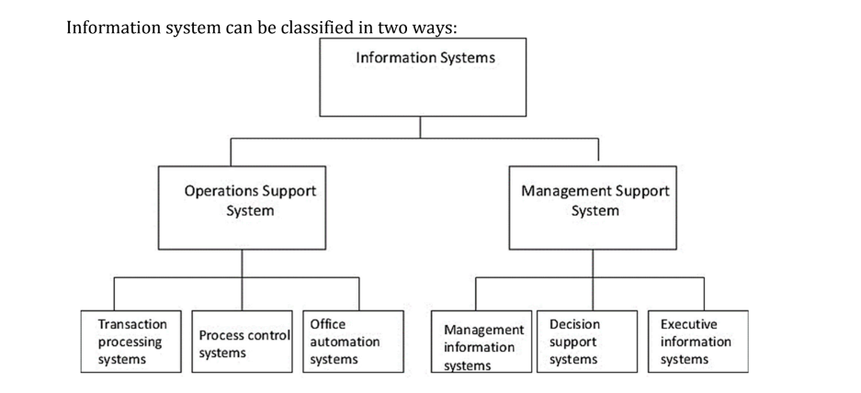
Types of Information systems

Slide 27
Transaction Processing System (TPS)
A Transaction Processing System (TPS) is an information system used by organizations to collect, store, retrieve, and process transactions, typically involving routine business operations. TPSs play a fundamental role in supporting the day-to-day activities of an organization by ensuring that transactions are processed efficiently, accurately, and in a timely manner.
Functionality:
Data Collection: TPSs capture transactional data from various sources, such as point-of-sale terminals, online transactions, and manual input by users.
Data Storage: Transactional data is stored in a database system, usually organized in a structured format to facilitate retrieval and processing.
Data Processing: TPSs perform predefined processing tasks on transactional data, such as validation, verification, calculation, and updating of records.
Transaction Management: TPSs manage the entire transaction lifecycle, from initiation to completion, ensuring that transactions are processed accurately and reliably.
Concurrency Control: TPSs implement mechanisms to manage concurrent access to shared data by multiple users or processes, preventing data inconsistencies and ensuring data integrity.
Transaction Monitoring: TPSs monitor transaction processing activities in real-time, providing feedback and alerts to users or administrators in case of errors, exceptions, or system failures.
Reporting: TPSs generate transaction reports and summaries for operational analysis, management reporting, and regulatory compliance purposes.

Slide 28
TPS
Characteristics:
High Volume: TPSs are designed to handle large volumes of transactions, often processing thousands or even millions of transactions per day.
High Speed: TPSs are optimized for fast transaction processing, with low response times and high throughput to meet real-time processing requirements.
Reliability: TPSs prioritize data integrity, reliability, and fault tolerance to ensure that transactions are processed accurately and reliably, even in the event of system failures or disruptions.
Consistency: TPSs maintain data consistency by enforcing transactional integrity constraints and ensuring that transactions are processed in a serializable or consistent manner.
Scalability: TPSs are scalable to accommodate growing transaction volumes and user loads, allowing organizations to expand their operations without compromising performance.

Slide 29
TPS
Examples:
Banking Systems: TPSs are used in banking systems to process transactions such as deposits, withdrawals, fund transfers, and loan payments.
Retail Point-of-Sale (POS) Systems: TPSs in retail POS systems handle transactions involving sales, inventory updates, and payment processing at checkout counters.
Online Transaction Systems: TPSs power e-commerce websites and online payment gateways, processing transactions for online purchases, reservations, and bookings.
Airline Reservation Systems: TPSs manage airline reservation systems, processing ticket bookings, seat allocations, and flight scheduling transactions.

Slide 30
Process Control System
A Process Control System (PCS) is an information system used in industrial and manufacturing environments to monitor, control, and optimize production processes. PCSs play a crucial role in ensuring that industrial processes operate efficiently, safely, and reliably
Functionality:
Data Acquisition: PCSs collect data from various sensors, instruments, and devices installed within the production environment. This data includes measurements such as temperature, pressure, flow rate, level, and quality parameters.
Data Processing: The collected data is processed in real-time by the PCS to monitor the current state of the production process. Algorithms and control logic are applied to analyze the data and make decisions regarding process control actions.
Control Actions: Based on the analysis of the data, the PCS initiates control actions to adjust process variables and parameters to maintain optimal operating conditions. These control actions can include opening or closing valves, adjusting pump speeds, changing setpoints, or triggering alarms.
Feedback Control: PCSs utilize feedback control loops to continuously monitor process variables and compare them to desired setpoints. If deviations from setpoints are detected, corrective actions are taken automatically to bring the process back to the desired state.
Safety Systems: PCSs incorporate safety systems to detect abnormal conditions, equipment failures, or hazardous situations within the production environment. Emergency shutdown systems (ESD) and safety interlocks are used to prevent accidents and ensure personnel safety.
Integration: PCSs are often integrated with other systems within the manufacturing environment, such as Supervisory Control and Data Acquisition (SCADA) systems, Manufacturing Execution Systems (MES), and Enterprise Resource Planning (ERP) systems, to enable seamless data exchange and coordination.

Slide 31
Process Control System
Types of Process Control:
Continuous Control: Continuous control systems regulate process variables in real-time to maintain them within predefined tolerances. Examples include temperature control in chemical reactors and pressure control in pipelines.
Discrete Control: Discrete control systems manage discrete events or operations within the production process, such as opening or closing valves, starting or stopping equipment, or triggering alarms based on predefined conditions.
Sequential Control: Sequential control systems sequence and coordinate the execution of multiple process steps or operations in a predefined sequence. They ensure that operations are performed in the correct order and timing.
Batch Control: Batch control systems manage batch-oriented production processes, where products are manufactured in discrete batches with specific recipes or formulations. They control the sequence of steps, recipe parameters, and material flows to produce consistent and quality products.

Slide 32
Process Control System
Examples:
Chemical Process Control: PCSs are used in chemical manufacturing plants to control variables such as temperature, pressure, flow rates, and chemical concentrations in reactors, distillation columns, and other process units.
Oil Refining Control: PCSs regulate refining processes in oil refineries to produce various petroleum products such as gasoline, diesel, and jet fuel. They control variables such as temperature, pressure, and product compositions in refining units.
Power Plant Control: PCSs monitor and control power generation processes in power plants, including steam turbines, gas turbines, and boilers. They regulate parameters such as steam pressure, turbine speed, and fuel flow to optimize power generation efficiency.
Food and Beverage Processing Control: PCSs manage production processes in food and beverage processing plants, controlling variables such as mixing, cooking, cooling, and packaging to ensure product quality and safety.

Slide 33
Office automation system
An Office Automation System (OAS) is an information system designed to automate and streamline routine office tasks, processes, and workflows within an organization. OASs leverage technology to improve productivity, efficiency, and collaboration among office staff by digitizing manual and paper-based processes.

Slide 34
OAS
Functionality:
Document Management: OASs facilitate the creation, storage, retrieval, and sharing of electronic documents, reducing reliance on paper-based documents and improving document management efficiency.
Email and Communication: OASs provide email and messaging capabilities to facilitate communication among employees within the organization. They enable sending and receiving emails, scheduling meetings, and sharing documents.
Calendar and Scheduling: OASs include calendar and scheduling features to help employees manage their appointments, meetings, and deadlines effectively. They allow users to schedule meetings, set reminders, and coordinate events with colleagues.
Word Processing: OASs offer word processing tools for creating, editing, and formatting documents such as letters, memos, reports, and presentations. They provide features like spell-check, formatting options, and templates.
Spreadsheet and Data Analysis: OASs include spreadsheet applications for performing calculations, data analysis, and creating charts and graphs. They help users manage numerical data, perform complex calculations, and visualize data trends.
Database Management: OASs include database management tools for creating and managing databases to store and retrieve organizational data. They enable users to organize, query, and analyze large volumes of structured data.
Workflow Automation: OASs automate routine office workflows and processes, such as document approval, expense reimbursement, and leave requests. They route documents and tasks electronically, streamlining approval processes and reducing manual intervention.
Collaboration Tools: OASs provide collaboration tools such as shared document repositories, project management platforms, and team messaging channels to facilitate teamwork and collaboration among employees.
Remote Access: OASs offer remote access capabilities, allowing employees to access office resources and applications from anywhere using internet-enabled devices. This enables flexible work arrangements and remote collaboration.
Security and Access Control: OASs implement security measures to protect sensitive information and ensure data confidentiality, integrity, and availability. They include user authentication, access controls, encryption, and data backup features.

Slide 35
OAS
Examples:
Microsoft Office Suite: Microsoft Office includes applications such as Word (word processing), Excel (spreadsheet), PowerPoint (presentation), Outlook (email), and SharePoint (collaboration), which together form a comprehensive OAS.
Google Workspace (formerly G Suite): Google Workspace offers cloud-based productivity tools, including Google Docs, Sheets, Slides, Gmail, Calendar, and Drive, designed for collaboration and remote work.
Zoho Office Suite: Zoho Office Suite provides a suite of online productivity tools, including Writer (word processing), Sheet (spreadsheet), Show (presentation), Mail (email), and Docs (document collaboration).
Apple iWork Suite: Apple iWork includes applications such as Pages (word processing), Numbers (spreadsheet), and Keynote (presentation), designed for Mac and iOS devices, with collaboration features via iCloud.

Slide 36
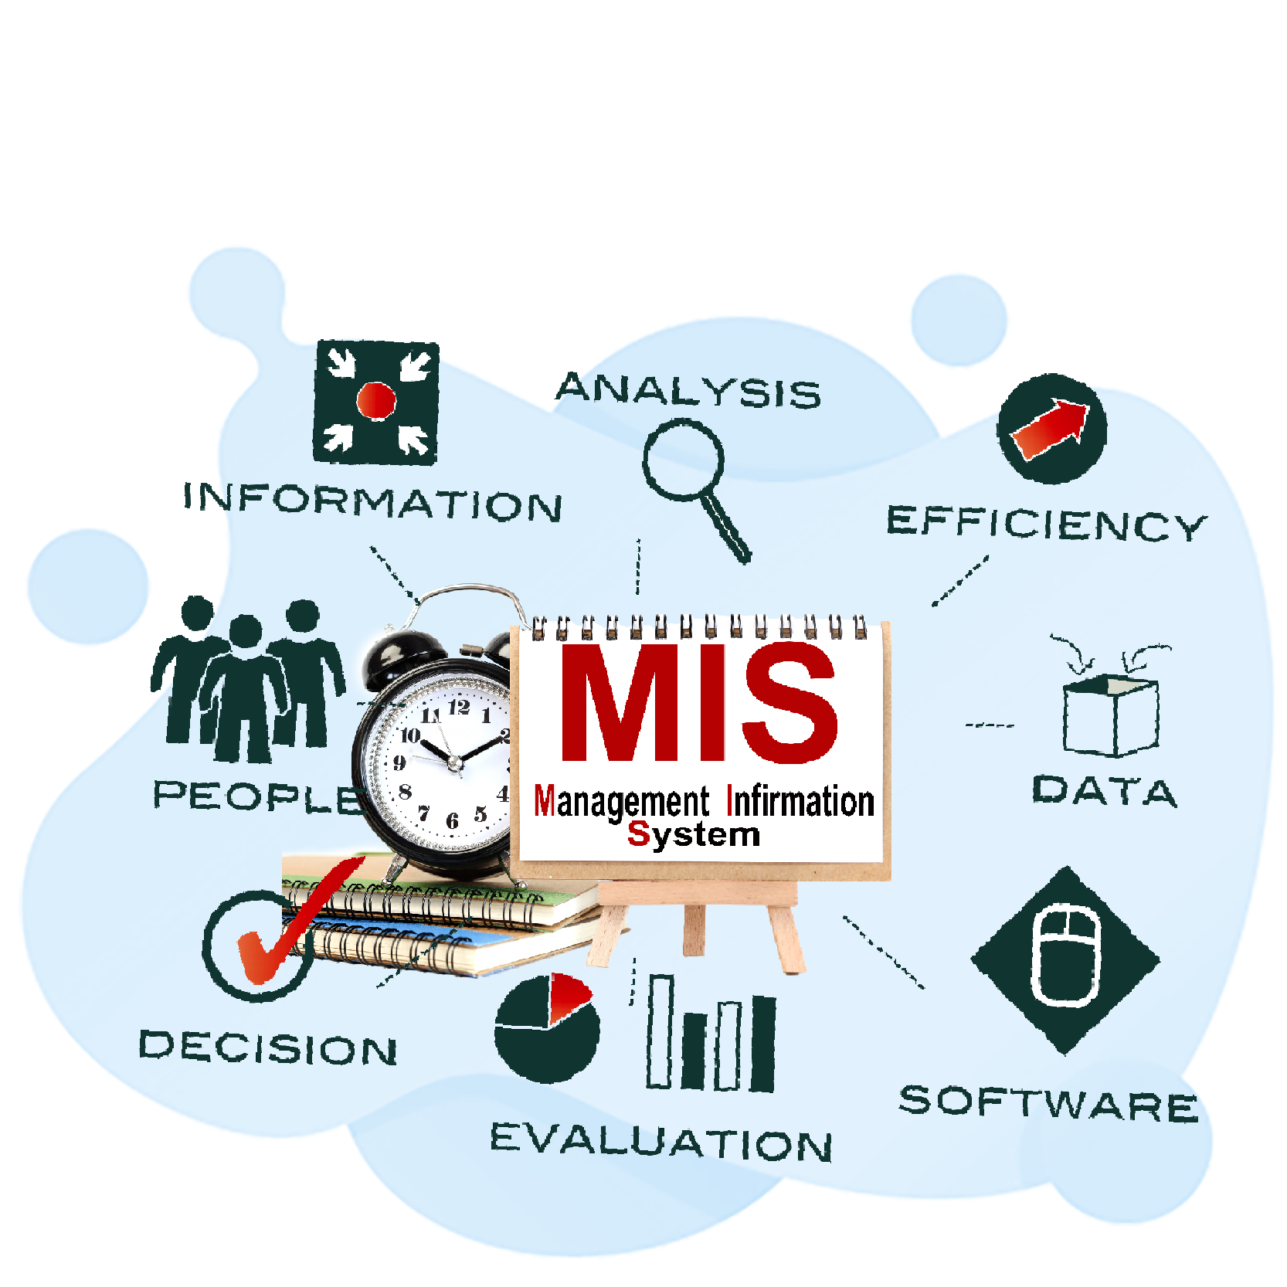
MIS
A Management Information System (MIS) is a computerized information system that provides managers at different levels of an organization with the tools and information they need to make informed decisions and manage the organization effectively. MISs collect, process, store, and disseminate information to support managerial functions and activities.

Slide 37
MIS
Functionality:
Data Collection: MISs gather data from various internal and external sources, including transactional systems, databases, spreadsheets, and external sources such as market research reports and industry publications.
Data Processing: The collected data is processed, organized, and transformed into meaningful information through various operations such as sorting, summarizing, aggregating, and calculating key performance indicators (KPIs).
Data Storage: Processed information is stored in a centralized database or data warehouse, organized in a structured format to facilitate retrieval, analysis, and reporting.
Information Retrieval: MISs provide users with tools and interfaces to access and retrieve relevant information from the stored data, using queries, filters, and search functionalities.
Analysis and Reporting: MISs analyze data to identify trends, patterns, and insights that are relevant to managerial decision-making. They generate reports, dashboards, and visualizations to present information in a format that is understandable and actionable.
Decision Support: MISs provide decision support tools and capabilities to assist managers in evaluating alternatives, forecasting outcomes, and assessing the potential impact of decisions on the organization.
Planning and Control: MISs support planning and control activities by providing managers with information on performance against goals, budgets, and targets. They help identify deviations from plans and take corrective actions as needed.
Communication and Collaboration: MISs facilitate communication and collaboration among managers and employees by providing shared access to information, collaborative workspaces, and communication channels.

Slide 38
MIS
Characteristics:
Management Orientation: MISs are designed to meet the information needs of managers at different levels of the organization, including operational, tactical, and strategic levels.
Integration: MISs integrate data from multiple sources and departments within the organization to provide a comprehensive view of organizational performance.
Timeliness: MISs provide timely access to information, allowing managers to make decisions based on up-to-date and relevant data.
Relevance: MISs focus on providing information that is relevant to managerial decision-making and supports organizational goals and objectives.
Flexibility: MISs are designed to be flexible and adaptable to changing business needs, allowing for customization and modification as required.

Slide 39
MIS
Examples:
Sales Reporting System: A MIS that tracks sales data, analyzes sales performance, forecasts sales trends, and generates sales reports for sales managers and executives.
Inventory Management System: A MIS that monitors inventory levels, tracks stock movements, forecasts demand, and generates inventory reports for inventory managers and procurement teams.
Financial Reporting System: A MIS that consolidates financial data from various departments, prepares financial statements, analyzes financial performance, and generates financial reports for senior management and stakeholders.
Human Resource Information System (HRIS): A MIS that manages employee data, tracks HR metrics, supports recruitment and onboarding processes, and generates HR reports for HR managers and executives.

Slide 40
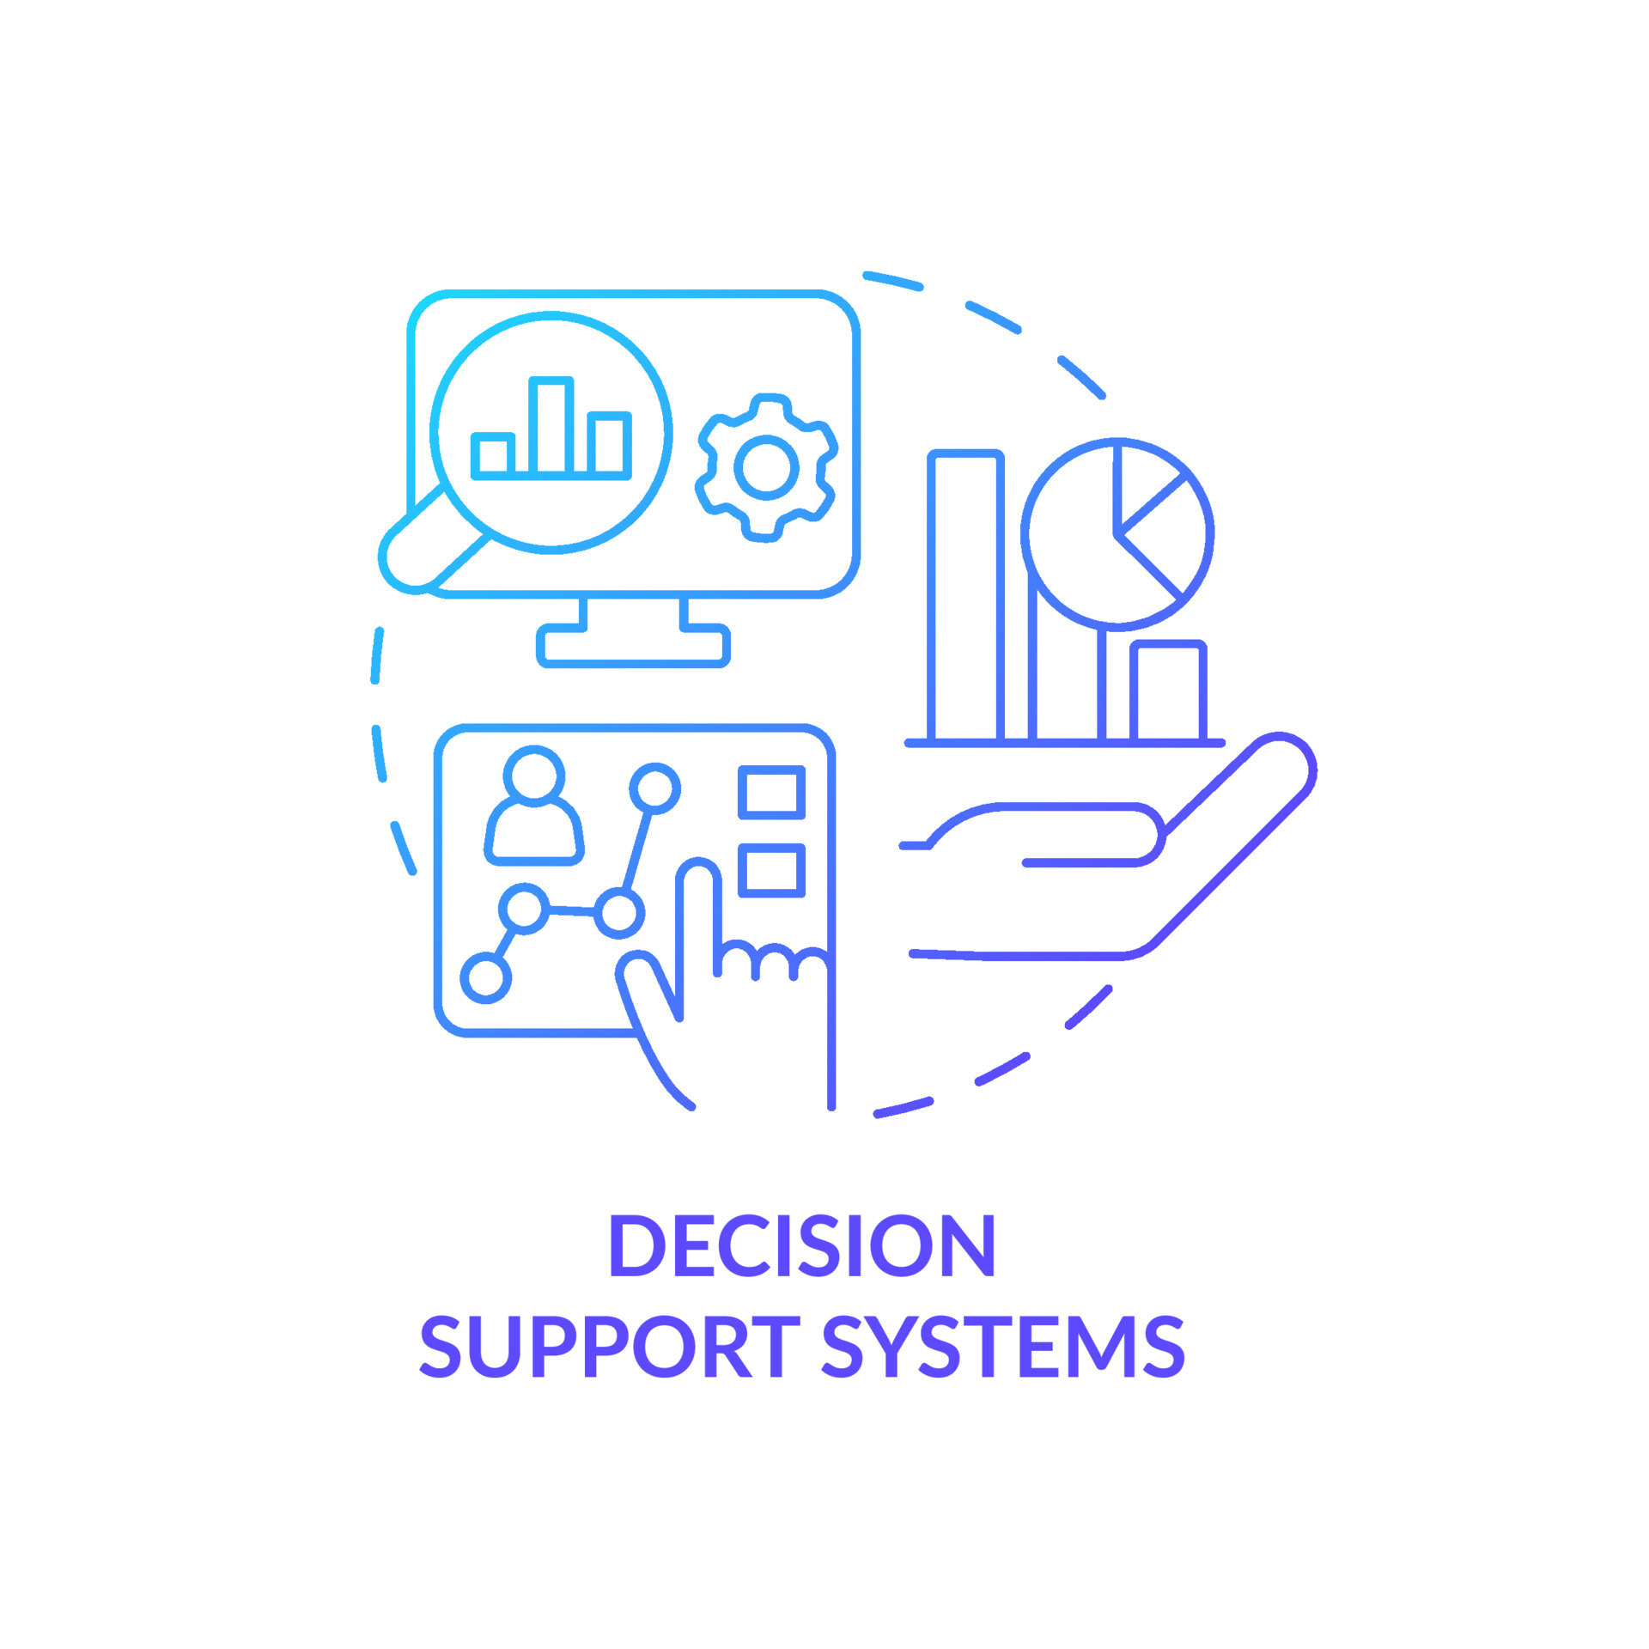
Decision support system
A Decision Support System (DSS) is an interactive computer-based system designed to support decision-making processes within an organization. DSSs provide managers and other decision-makers with the necessary information, analysis tools, and models to make better decisions, solve problems, and achieve organizational objectives

Slide 41
DSS
Components:
Database Management System (DBMS): DSSs often rely on a database management system to store and manage data from various sources. This data may include internal operational data, historical data, and external data such as market research reports or industry statistics.
Model Base: Decision Support Systems incorporate models or algorithms to analyze data and predict outcomes. These models can range from simple statistical techniques to complex mathematical models and simulation tools.
User Interface: DSSs provide a user-friendly interface that allows decision-makers to interact with the system, input data, adjust parameters, and view results. The interface may include graphical tools, dashboards, and reporting features to facilitate understanding and interpretation.
Decision Support Tools: DSSs offer a range of decision support tools and functionalities to assist users in analyzing data, evaluating alternatives, and making decisions. These tools may include what-if analysis, scenario planning, sensitivity analysis, and optimization techniques.
Knowledge Base: Some DSSs incorporate a knowledge base containing relevant domain knowledge, rules, heuristics, or best practices to guide decision-making processes. This knowledge base may be derived from experts within the organization or external sources.

Slide 42
DSS
Functionality:
Data Analysis: DSSs analyze data from multiple sources to identify patterns, trends, and relationships that may inform decision-making. This analysis may involve querying databases, aggregating data, performing statistical analysis, and generating reports.
What-If Analysis: DSSs support what-if analysis by allowing users to explore different scenarios and assess the potential impact of various decisions. Users can adjust input parameters and evaluate how changes affect outcomes.
Visualization: DSSs often incorporate data visualization techniques to present information in a visual format, such as charts, graphs, and maps. Visualization enhances understanding and interpretation of data, making it easier for decision-makers to identify insights and trends.
Collaboration: Some DSSs facilitate collaboration among decision-makers by providing shared access to data, analysis tools, and decision support capabilities. Collaborative features enable stakeholders to work together on decision-making tasks, share insights, and reach consensus.

Slide 43
DSS
Examples:
Executive Information Systems (EIS): EISs are specialized DSSs designed for senior executives to support strategic decision-making. They provide summarized information, key performance indicators (KPIs), and trend analysis to help executives monitor organizational performance and identify strategic opportunities.
Business Intelligence Systems (BI): BI systems collect, analyze, and present data to support decision-making processes within an organization. They provide managers with insights into sales trends, customer behavior, market dynamics, and other business metrics.
Clinical Decision Support Systems (CDSS): CDSSs assist healthcare professionals in diagnosing diseases, selecting treatments, and managing patient care. They analyze patient data, medical literature, and best practices to provide recommendations and alerts at the point of care.
Supply Chain Management Systems (SCM): SCM systems use DSS capabilities to optimize supply chain operations, such as inventory management, demand forecasting, and logistics planning. They help organizations make more efficient use of resources, reduce costs, and improve customer service.

Slide 44
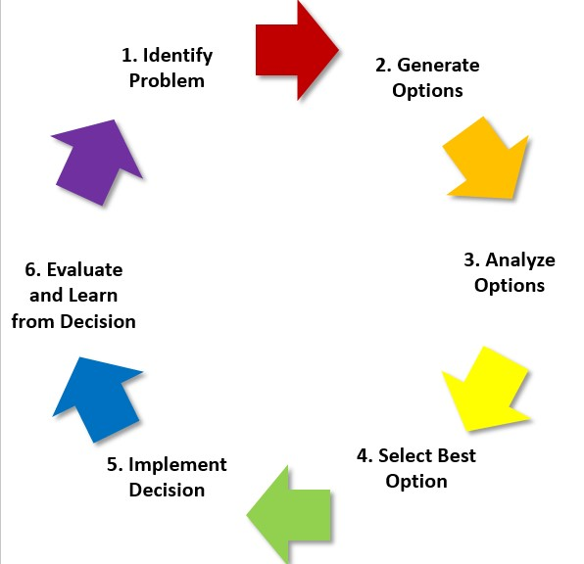
Stages in Decision Making

Slide 45
Executive support system
An Executive Support System (ESS) is a specialized type of Decision Support System (DSS) designed to meet the information needs of top-level executives in an organization. ESSs provide senior management with access to summarized, high-level information from various sources to support strategic decision-making and facilitate the achievement of organizational goals

Slide 46
ESS
Functionality:
Aggregation and Summarization: ESSs aggregate and summarize data from multiple internal and external sources to provide executives with a comprehensive view of organizational performance, market trends, and competitive intelligence. This information is often presented in the form of executive dashboards, scorecards, and summary reports.
Customization and Personalization: ESSs allow executives to customize and personalize their information views based on their specific information needs, preferences, and priorities. Executives can configure dashboards, set key performance indicators (KPIs), and define alerts or notifications for important events or trends.
Integration with External Data Sources: ESSs integrate data from external sources such as market research reports, industry benchmarks, economic indicators, and news feeds to provide executives with valuable insights into the external business environment. This external data helps executives to identify opportunities, threats, and emerging trends that may impact the organization's strategy.
Strategic Analysis and Decision Support: ESSs support strategic analysis and decision-making by providing executives with tools and capabilities to analyze data, perform scenario planning, and evaluate strategic alternatives. Executives can conduct what-if analysis, simulate the impact of different strategies, and assess the potential risks and rewards of strategic decisions.
Communication and Collaboration: ESSs facilitate communication and collaboration among executives and other stakeholders by providing shared access to information, discussion forums, and collaboration tools. Executives can share insights, discuss strategic issues, and align their actions to achieve common goals.
Forecasting and Prediction: ESSs incorporate forecasting and prediction capabilities to help executives anticipate future trends, market conditions, and business outcomes. Executives can use predictive analytics and modeling techniques to forecast sales, demand, and financial performance, enabling proactive decision-making and strategic planning.

Slide 47
ESS
Characteristics:
Strategic Orientation: ESSs are designed to support strategic decision-making at the highest levels of the organization. They focus on providing executives with information and insights to guide long-term planning, goal-setting, and resource allocation.
Customization and Flexibility: ESSs offer flexibility and customization options to accommodate the unique information needs and preferences of different executives. Executives can tailor their ESS views to align with their strategic priorities and managerial responsibilities.
Real-Time Information Access: ESSs provide executives with real-time access to critical information and key performance indicators (KPIs) to enable timely decision-making and response to changing business conditions. Real-time data updates and alerts help executives stay informed and proactive in their decision-making.
High-Level Summary and Aggregation: ESSs present information in a highly summarized and aggregated format to provide executives with a holistic view of organizational performance and strategic priorities. This high-level perspective enables executives to focus on the most critical issues and strategic initiatives.
User-Friendly Interface: ESSs feature user-friendly interfaces that are intuitive and easy to use, even for non-technical executives. Executives can navigate ESS dashboards, drill down into detailed data, and perform analysis without requiring specialized technical skills.

Slide 48
ESS
Examples:
Executive Dashboards: ESSs often include executive dashboards that display key performance indicators (KPIs), metrics, and summary reports in a visually appealing and easy-to-understand format. Executives can monitor overall organizational performance at a glance and track progress towards strategic goals.
Strategic Planning Software: ESSs may include strategic planning software that helps executives develop, communicate, and execute strategic plans. These software tools enable executives to define strategic objectives, allocate resources, and monitor progress towards achieving strategic goals.
Market Intelligence Platforms: ESSs may integrate market intelligence platforms that provide executives with insights into market trends, customer behavior, and competitor activities. Executives can use this information to identify opportunities for growth, assess market risks, and formulate competitive strategies.

Slide 49
Expert System
An Expert System (ES) is a computer-based information system that emulates the decision-making ability of a human expert in a specific domain or field of knowledge. Expert systems are designed to solve complex problems, provide advice, or make decisions by reasoning through a set of rules, facts, and heuristics derived from the expertise of human experts
Components:
Knowledge Base: The knowledge base is the core component of an expert system, containing the domain-specific knowledge, rules, facts, and heuristics derived from human experts. The knowledge base is typically represented using a structured format such as production rules, frames, or semantic networks.
Inference Engine: The inference engine is the reasoning mechanism of the expert system that processes the knowledge stored in the knowledge base to generate solutions, recommendations, or decisions. The inference engine applies logical reasoning, pattern matching, and inference algorithms to derive conclusions from the available knowledge.
User Interface: The user interface provides a means for users to interact with the expert system, input data, query the system, and receive responses or recommendations. The user interface may include graphical interfaces, natural language interfaces, or interactive dialogues to facilitate communication between the user and the system.
Explanation Facility: Many expert systems include an explanation facility that provides explanations or justification for the system's recommendations, decisions, or actions. The explanation facility helps users understand how the system arrived at its conclusions and builds trust in the system's capabilities.

Slide 50
Integrated information system
An Integrated Information System (IIS) refers to a comprehensive and cohesive system that combines various subsystems and components within an organization to streamline processes, improve efficiency, and enhance decision-making capabilities. An IIS integrates different functional areas and departments of an organization by consolidating data, processes, and technologies into a unified system
Components:
Data Integration: An IIS integrates data from disparate sources and systems across the organization, including databases, applications, and legacy systems. Data integration ensures consistency, accuracy, and accessibility of information across the organization.
Process Integration: IIS integrates business processes and workflows across different functional areas and departments to optimize operations and improve collaboration. Process integration facilitates end-to-end process automation, reduces redundancy, and enhances efficiency.
Technology Integration: IIS integrates various technologies, platforms, and software applications to create a seamless and interoperable IT infrastructure. Technology integration enables data sharing, communication, and collaboration across the organization's IT ecosystem.
User Interface Integration: IIS provides a unified user interface that aggregates information and functionalities from multiple systems into a single interface. User interface integration improves usability, reduces complexity, and enhances user experience for employees.

Slide 51
IIS
Benefits:
Increased Efficiency: Integration of systems and processes reduces manual effort, eliminates duplicate data entry, and minimizes errors, leading to increased operational efficiency.
Improved Decision Making: Integrated information enables better-informed decision-making by providing a holistic view of organizational data and performance metrics.
Enhanced Customer Experience: Streamlined processes and improved access to information enable organizations to deliver better customer service and support.
Cost Savings: Integration reduces IT complexity, maintenance costs, and licensing fees associated with managing multiple systems and applications separately.
Competitive Advantage: Organizations with integrated information systems can respond more quickly to market changes, innovate faster, and gain a competitive edge over rivals.

Slide 52
Communication & Collaboration System
A Communication and Collaboration System (CCS) is an integrated platform or suite of tools that enables individuals and teams within an organization to communicate, share information, and collaborate on projects and tasks. CCSs facilitate real-time and asynchronous communication, document sharing, task management, and coordination among employees, regardless of their location or time zone.

Slide 53
CCS
Components:
Messaging and Chat: CCSs provide messaging and chat functionalities that allow users to send real-time messages, participate in group chats, and have one-on-one conversations. These tools facilitate quick and informal communication among team members.
Video and Audio Conferencing: CCSs offer video and audio conferencing capabilities that enable users to conduct virtual meetings, presentations, and discussions. Video conferencing tools allow participants to see each other, share screens, and collaborate in real-time, regardless of their physical location.
Document Collaboration: CCSs include document collaboration features that enable users to create, edit, and share documents, spreadsheets, presentations, and other files in real-time. Document collaboration tools support version control, commenting, and simultaneous editing by multiple users.
Task and Project Management: CCSs provide task and project management functionalities that help teams organize, prioritize, and track tasks and projects. Task management tools allow users to create task lists, assign tasks to team members, set deadlines, and monitor progress.
Calendar and Scheduling: CCSs include calendar and scheduling tools that help users manage appointments, meetings, and events. Calendar tools enable users to schedule meetings, send invitations, and view availability across team members' calendars.
File Sharing and Storage: CCSs offer file sharing and storage capabilities that allow users to upload, store, and access files and documents from any device and location. File sharing tools support secure sharing, permissions management, and file synchronization.
Collaborative Editing: CCSs enable collaborative editing of documents, spreadsheets, and presentations, allowing multiple users to work together on the same file simultaneously. Collaborative editing tools track changes, resolve conflicts, and maintain data integrity.

Slide 54
CCS
Functionality:
Real-time Communication: CCSs facilitate real-time communication through instant messaging, chat, and video conferencing tools, enabling quick decision-making and problem-solving.
Asynchronous Collaboration: CCSs support asynchronous collaboration by providing document sharing, task management, and file storage functionalities that allow users to collaborate at their own pace and convenience.
Cross-platform Compatibility: CCSs are accessible across multiple devices and platforms, including desktop computers, laptops, smartphones, and tablets, ensuring seamless communication and collaboration regardless of device or location.
Integration with Other Systems: CCSs integrate with other systems and applications used within the organization, such as email, calendar, project management, and customer relationship management (CRM) systems, to streamline workflows and improve productivity.
Security and Compliance: CCSs prioritize security and compliance by implementing measures such as data encryption, access controls, user authentication, and compliance with industry standards and regulations.

Slide 55
CCS
Benefits:
Improved Communication: CCSs facilitate better communication among team members, leading to increased transparency, alignment, and knowledge sharing within the organization.
Enhanced Collaboration: CCSs enable seamless collaboration on projects and tasks, allowing teams to work together more effectively, regardless of geographical boundaries or time zones.
Increased Productivity: CCSs streamline workflows, reduce manual effort, and eliminate communication barriers, resulting in improved productivity and efficiency across the organization.
Faster Decision-making: CCSs enable faster decision-making by providing real-time access to information, quick communication channels, and collaborative decision-making tools.
Flexibility and Scalability: CCSs are flexible and scalable, allowing organizations to adapt to changing business needs, scale their operations, and accommodate growing teams and workloads.

Slide 56
CCS
Examples:
Microsoft Teams: Microsoft Teams is a unified communication and collaboration platform that integrates messaging, video conferencing, document collaboration, and task management features.
Slack: Slack is a messaging and collaboration platform that brings teams together to streamline communication, share files, and collaborate on projects in real-time.
Google Workspace (formerly G Suite): Google Workspace offers a suite of productivity and collaboration tools, including Gmail, Google Drive, Google Calendar, Google Docs, and Google Meet, designed to help teams work together more effectively.
Asana: Asana is a project management and collaboration tool that enables teams to plan, organize, and track tasks and projects, communicate in real-time, and collaborate on shared goals.
Zoom: Zoom is a video conferencing platform that allows users to host virtual meetings, webinars, and conferences, as well as share screens, collaborate on documents, and communicate via chat.

Slide 57
Knowledge management system
Knowledge Management System (KMS) is a software platform or framework that enables organizations to capture, store, organize, and share knowledge and information among employees, teams, and departments. KMSs facilitate the creation, dissemination, and utilization of knowledge assets within an organization to support decision-making, problem-solving, innovation, and organizational learning

Slide 58
Components:
Knowledge Repository: The central component of a KMS is the knowledge repository or database, where knowledge assets such as documents, articles, manuals, best practices, case studies, and lessons learned are stored and organized. The knowledge repository may utilize various formats, including text documents, multimedia files, and structured databases.
Knowledge Capture Tools: KMSs provide tools and mechanisms for capturing and inputting knowledge into the system. These tools may include document editors, knowledge submission forms, content management systems, and data capture interfaces.
Knowledge Organization and Classification: KMSs employ techniques for organizing and classifying knowledge assets to facilitate search and retrieval. This may involve categorization, tagging, indexing, and metadata management to organize knowledge by topic, domain, or relevance.
Search and Retrieval Functionality: KMSs offer search and retrieval capabilities that allow users to quickly find and access relevant knowledge assets. Search functionality may include keyword search, advanced search filters, natural language processing, and recommendation algorithms.
Collaboration and Social Features: KMSs incorporate collaboration and social features that enable users to share knowledge, ask questions, provide feedback, and collaborate on knowledge creation and refinement. These features may include discussion forums, social networking tools, and community-based platforms.
Knowledge Sharing and Distribution: KMSs facilitate the sharing and distribution of knowledge across the organization through various channels and mediums. This may include email alerts, newsletters, knowledge sharing sessions, training programs, and internal communication platforms.
Knowledge Analytics and Metrics: Some KMSs include analytics and reporting capabilities that provide insights into knowledge usage, adoption, and effectiveness. Analytics may track metrics such as content views, downloads, contributions, and user engagement to measure the impact of knowledge management initiatives.

Slide 59
Benefits:
Improved Decision-making: KMSs provide access to relevant and up-to-date knowledge, enabling better-informed decision-making and problem-solving.
Enhanced Productivity: KMSs streamline knowledge sharing and collaboration, reducing duplication of effort, accelerating innovation, and improving productivity across the organization.
Knowledge Retention: KMSs capture and preserve institutional knowledge, preventing loss of expertise and facilitating knowledge transfer between employees.
Faster Learning and Onboarding: KMSs support employee learning and onboarding by providing access to training materials, tutorials, and best practices, accelerating the learning curve for new hires and facilitating continuous learning for existing employees.
Innovation and Creativity: KMSs foster innovation and creativity by providing a platform for sharing ideas, lessons learned, and best practices, encouraging experimentation and knowledge exchange among employees.

Slide 60
Examples:
Wikis: Wikis are collaborative platforms that allow users to create, edit, and share content in a flexible and open manner. Organizations often use wikis as knowledge repositories for documenting processes, procedures, and organizational knowledge.
Document Management Systems (DMS): DMSs are software platforms that manage the creation, storage, retrieval, and version control of documents and files. DMSs serve as knowledge repositories for storing and organizing documents, manuals, and other written materials.
Enterprise Social Networks (ESNs): ESNs are internal social networking platforms that facilitate communication, collaboration, and knowledge sharing among employees. ESNs provide features such as discussion forums, groups, and messaging to encourage collaboration and information exchange.
Learning Management Systems (LMS): LMSs are software platforms that deliver, manage, and track training and educational programs for employees. LMSs serve as knowledge repositories for storing training materials, courses, and learning resources.
Content Management Systems (CMS): CMSs are software platforms that manage the creation, publishing, and organization of digital content, such as websites, blogs, and multimedia files. CMSs serve as knowledge repositories for publishing and sharing information with internal and external audiences.

